Slide 1

Introduction to Library Management System
The Library Management System is a crucial tool for organizing, managing, and accessing the extensive collection of resources in a library. It streamlines the process of borrowing, returning, and tracking books, thereby enhancing efficiency and user experience.

Slide 2

Purpose and Goals of the Project
1
Efficient Resource Utilization
To Update the record, monitor and add books.
2
User-Centric Approach
Providing a user-friendly interface and taking care of the issue date and return date.
3
Ease of Access
Basic features like creating a new record, updating and deleting it

Slide 3
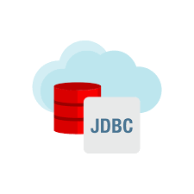
Features and Functionalities of the System
Database Management
Circulation Management
Efficient storage and retrieval of library resources.
Facilitating the borrowing and return processes.
Search and Discovery
Easy and comprehensive search and discovery of different types of books.

Slide 4




System Architecture and Design
Modular Design
Database Capacity
Integration Layers
Organized into tables for scalability and maintenance.
Designed for efficient data storage and retrieval.
Facilitating seamless integration with adding new blocks in tables.

Slide 5

Implementation Details and Technologies Used
1
Backend
2
Database
Java, JDBC, MySQL JDBC Connector
MySQL Community Server

Slide 6
Thank You!

